Slide 1
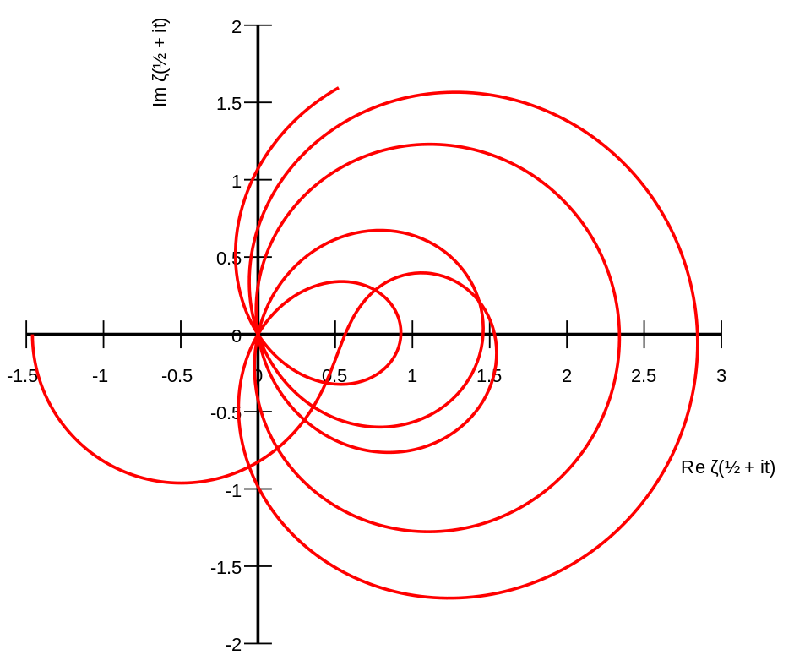
The Riemann Zeta Function Tasnia Kader Course: MATH 3138 Professor: Dr. Jeromy Sivek
Notes:
Hello, my name is Tasnia, and today I’ll be presenting the Riemann zeta function, one of the most intriguing and important functions in complex analysis and mathematics as a whole.

Slide 2
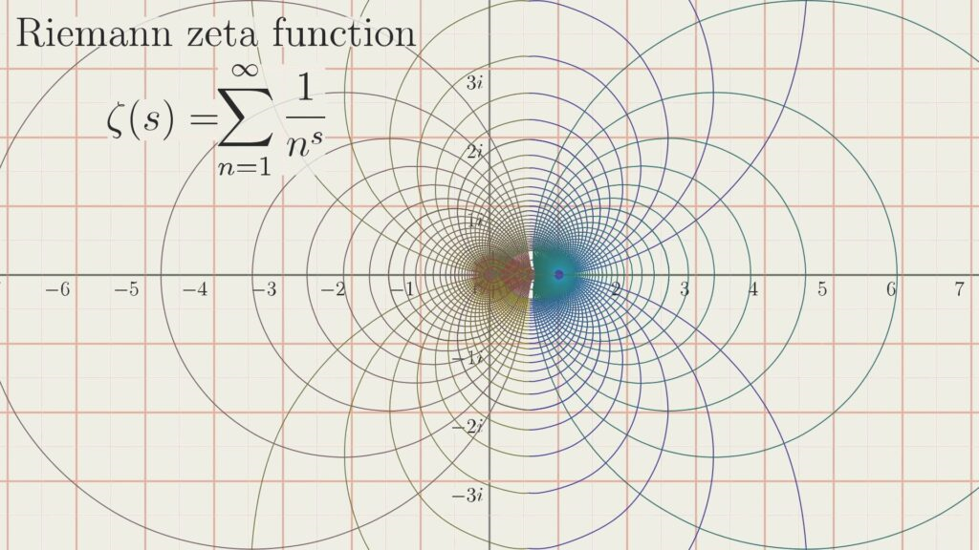
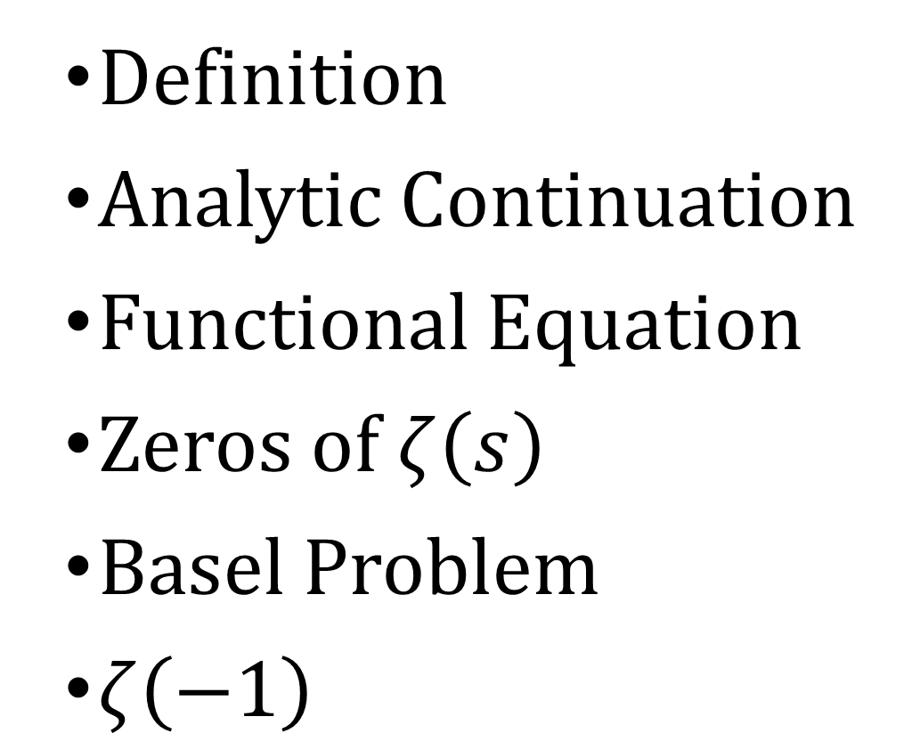
Agenda
Definition
Analytic Continuation
Functional Equation
Zeros of $ζ\left(s\right)$
Basel Problem
$ζ\left(−1\right)$
Notes:
This is today’s agenda. I will first provide the definition of the zeta function. Then I will introduce analytic continuation and the functional equation.
Next, we’ll explore the zeros of the function. We will wrap it up with the Basel Problem and zeta(-1).

Slide 3
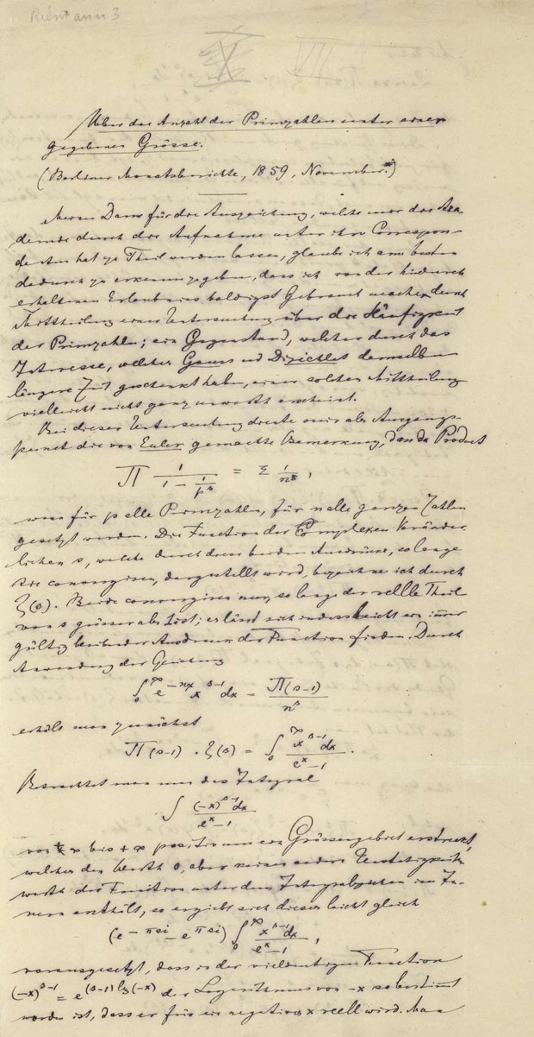
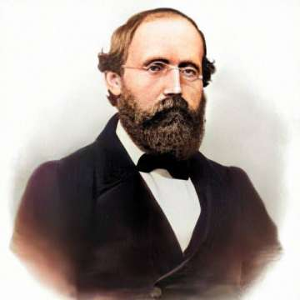
Bernhard Riemann (1826 – 1866)
Notes:
In his 1859 paper 'On the Number of Primes Less Than a Given Magnitude,' Bernhard Riemann aimed to understand how prime numbers are distributed. To approach this, he extended the definition of the zeta function to complex numbers, provided an analytic continuation of the function, explored several of its key properties, and even outlined a strategy for proving the Prime Number Theorem.

Slide 4
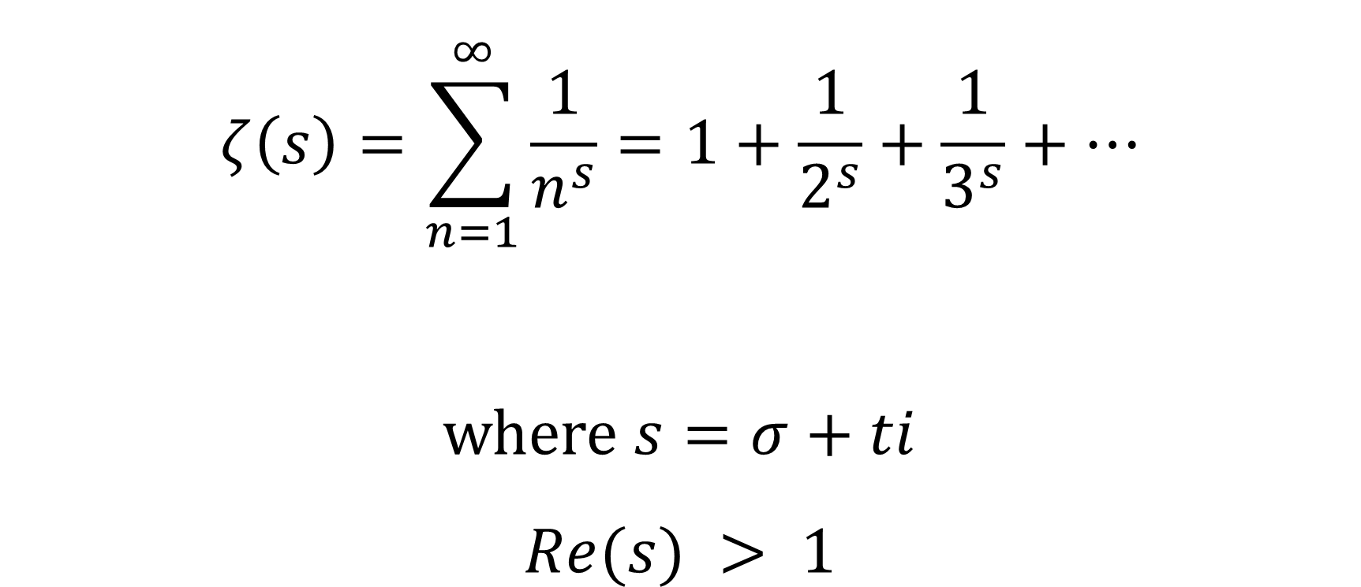
Definition
$$ζ\left(s\right)=\sum_{n=1}^{∞}{\frac{1}{n^{s}}}=1+\frac{1}{2^{s}}+\frac{1}{3^{s}}+…$$
where $s=σ+ti$
$$Re(s) > 1$$
Notes:
We begin with the definition of the zeta function. It’s defined as the infinite series: the sum from n equals one to infinity of one over n to the s.
Here s is a complex number with real part sigma and imaginary part t and the series only converges when the real part of s is greater than 1.

Slide 5
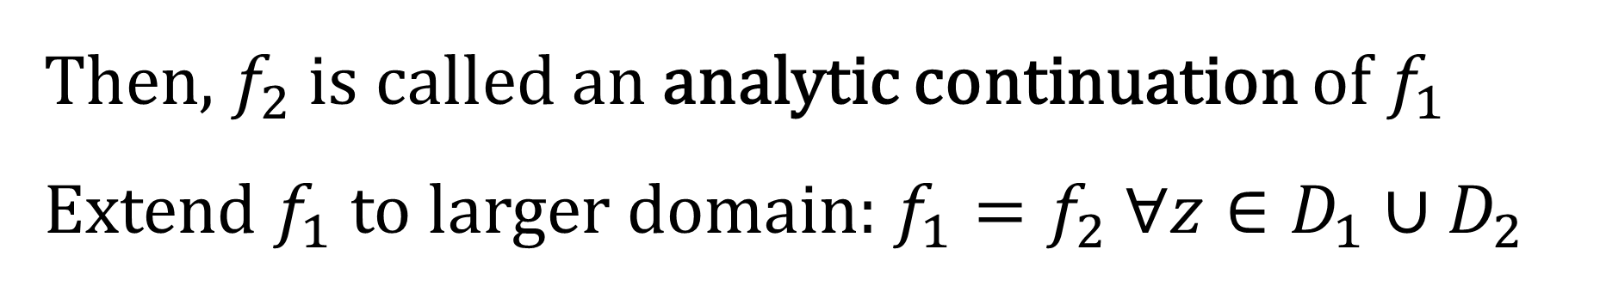
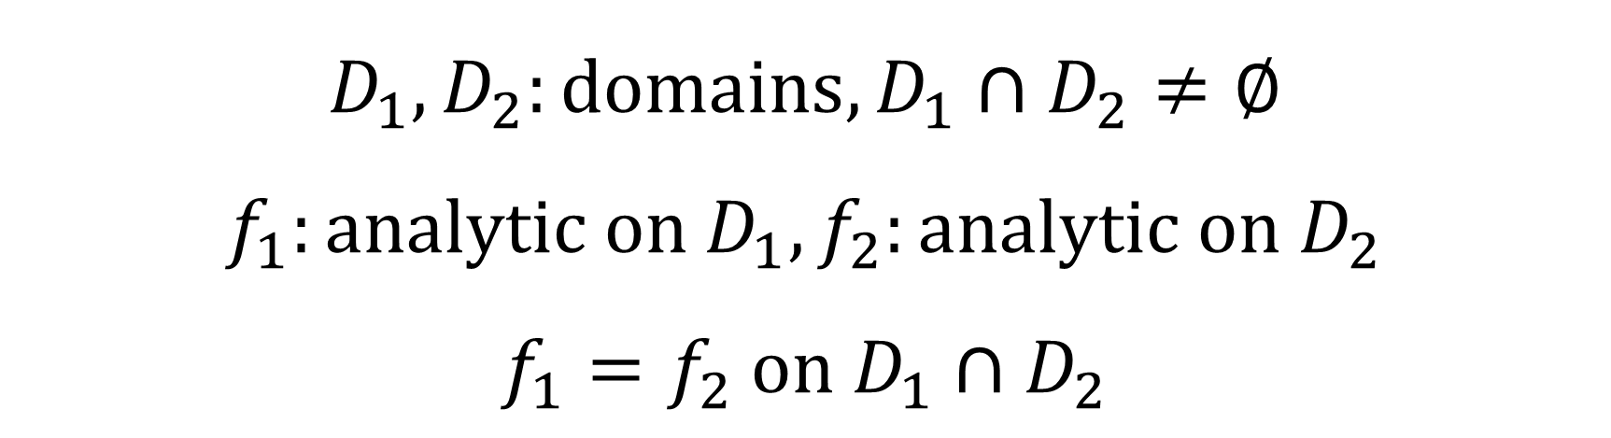
Analytic Continuation
If
$$D_{1}, D_{2}:domains, D_{1}∩D_{2}≠∅$$
$$f_{1}:analytic on D_{1}, f_{2}:analytic on D_{2}$$
$$f_{1}=f_{2} on D_{1}∩D_{2}$$
Then, $f_{2}$ is called an analytic continuation of $f_{1}$
Extend $f_{1}$ to larger domain: $f_{1}=f_{2} ∀z∈D_{1}∪D_{2}$

Slide 6
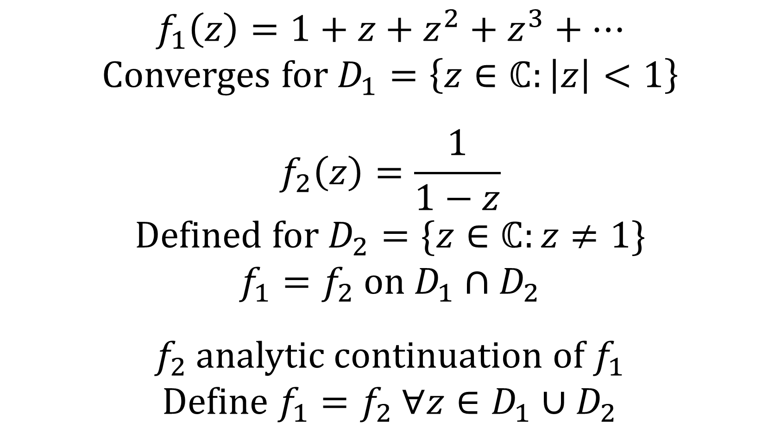
Example of Analytic Continuation
$$f_{1}\left(z\right)=1+z+z^{2}+z^{3}+…$$
Converges for $D_{1}=\left\{z∈ℂ:\left|z\right|<1\right\}$
$$f_{2}\left(z\right)=\frac{1}{1−z}$$
Defined for $D_{2}=\{z∈ℂ:z≠1\}$
$$f_{1}=f_{2} on D_{1}∩D_{2}$$
$f_{2}$ analytic continuation of $f_{1}$
Define $f_{1}=f_{2} ∀z∈D_{1}∪D_{2}$

Slide 7
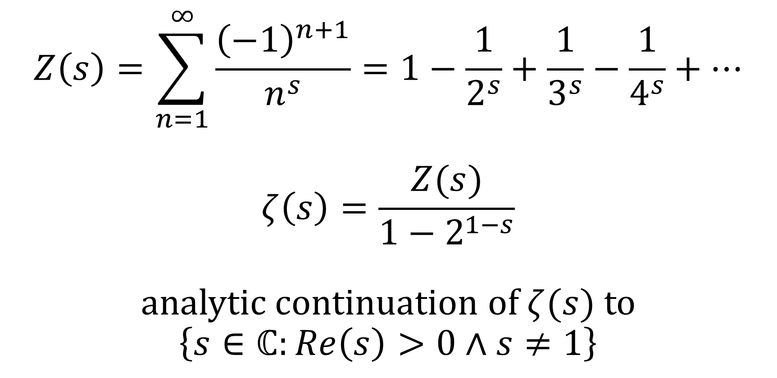

Analytic Continuation of $ζ(s)$
$$Z\left(s\right)=\sum_{n=1}^{∞}{\frac{{\left(−1\right)}^{n+1}}{n^{s}}}=1−\frac{1}{2^{s}}+\frac{1}{3^{s}}−\frac{1}{4^{s}}+…$$
$$ζ\left(s\right)=\frac{Z(s)}{1−2^{1−s}}$$
analytic continuation of $ζ(s)$ to
$$\left\{s∈ℂ:Re\left(s\right)>0∧s≠1\right\}$$

Slide 8
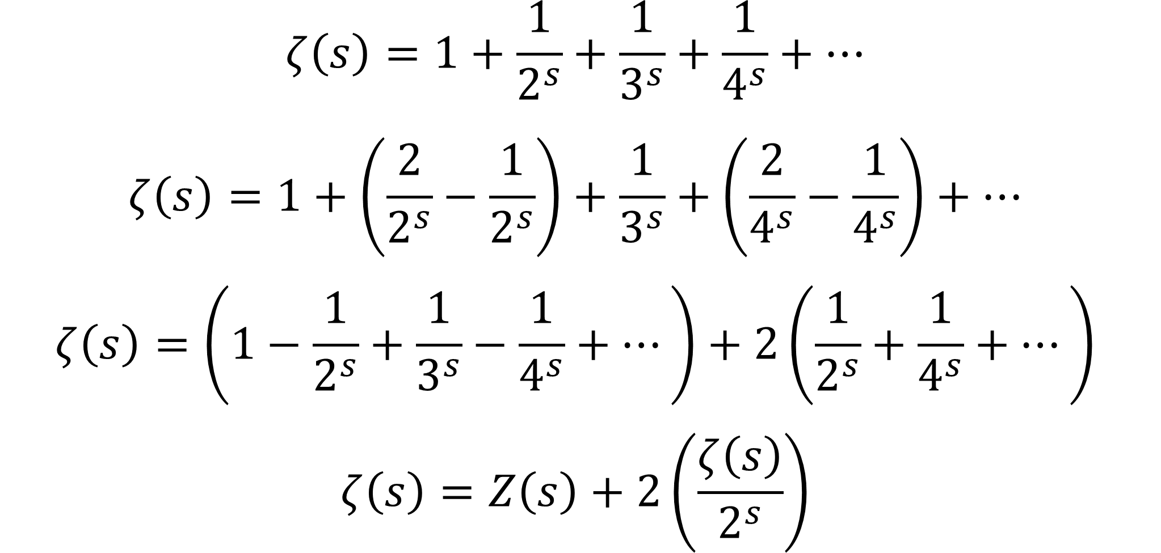
Proof
$$ζ\left(s\right)=1+\frac{1}{2^{s}}+\frac{1}{3^{s}}+\frac{1}{4^{s}}+…$$
$$ζ\left(s\right)=1+\left(\frac{2}{2^{s}}−\frac{1}{2^{s}}\right)+\frac{1}{3^{s}}+\left(\frac{2}{4^{s}}−\frac{1}{4^{s}}\right)+…$$
$$ζ\left(s\right)=\left(1−\frac{1}{2^{s}}+\frac{1}{3^{s}}−\frac{1}{4^{s}}+…\right)+2\left(\frac{1}{2^{s}}+\frac{1}{4^{s}}+…\right)$$
$$ζ\left(s\right)=Z\left(s\right)+2\left(\frac{ζ\left(s\right)}{2^{s}}\right)$$

Slide 9
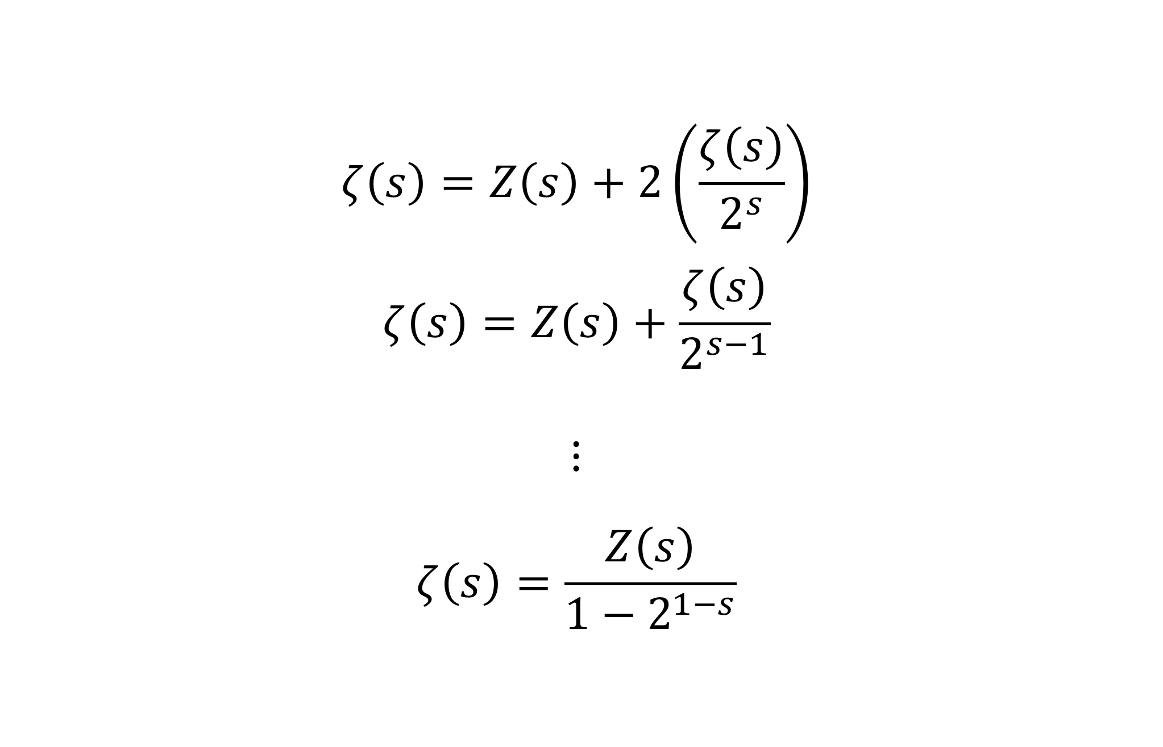
Proof Cont.
$$ζ\left(s\right)=Z\left(s\right)+2\left(\frac{ζ\left(s\right)}{2^{s}}\right)$$
$$ζ\left(s\right)=Z\left(s\right)+\frac{ζ\left(s\right)}{2^{s−1}}$$
$$⋮$$
$$ζ\left(s\right)=\frac{Z\left(s\right)}{{1−2}^{1−s}}$$

Slide 10
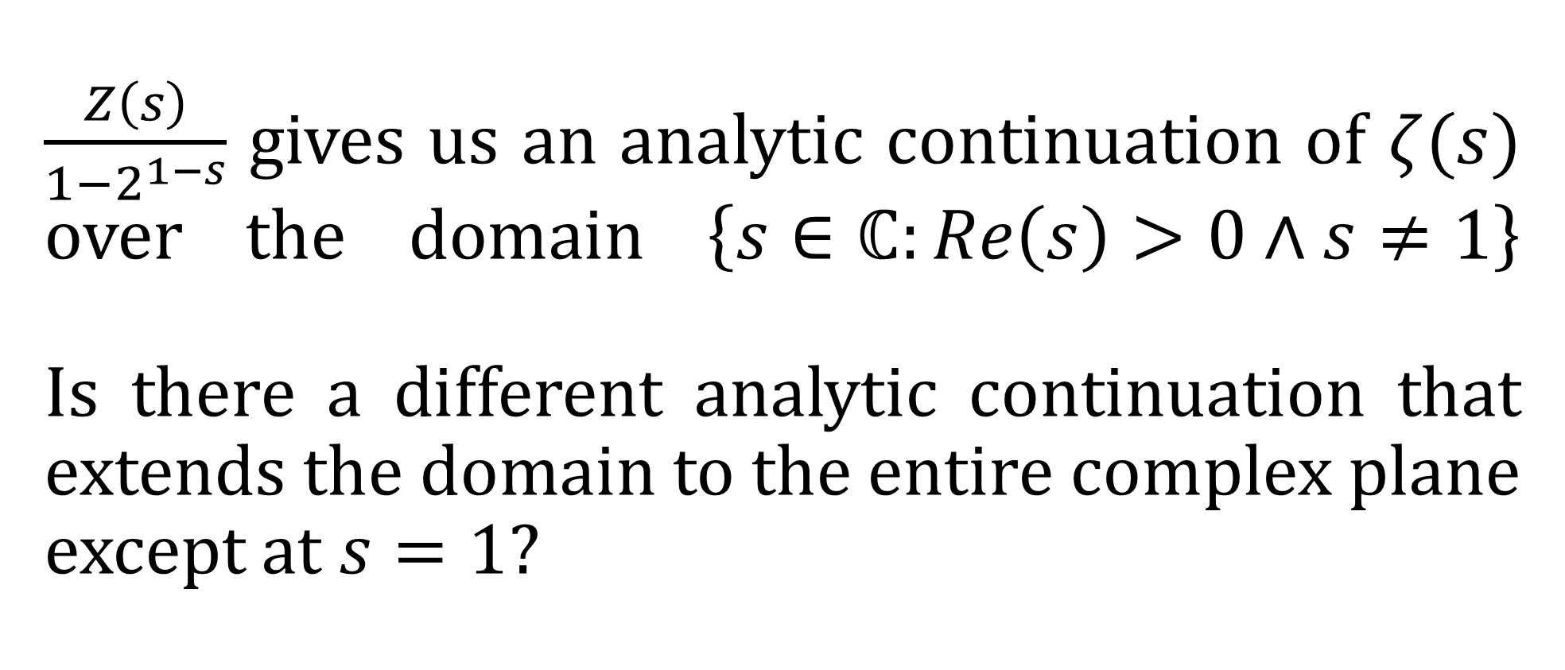
$\frac{Z\left(s\right)}{1−2^{1−s}}$ gives us an analytic continuation of $ζ(s)$ over the domain $\left\{s∈ℂ:Re\left(s\right)>0∧s≠1\right\}$ Is there a different analytic continuation that extends the domain to the entire complex plane except at $s=1$?

Slide 11
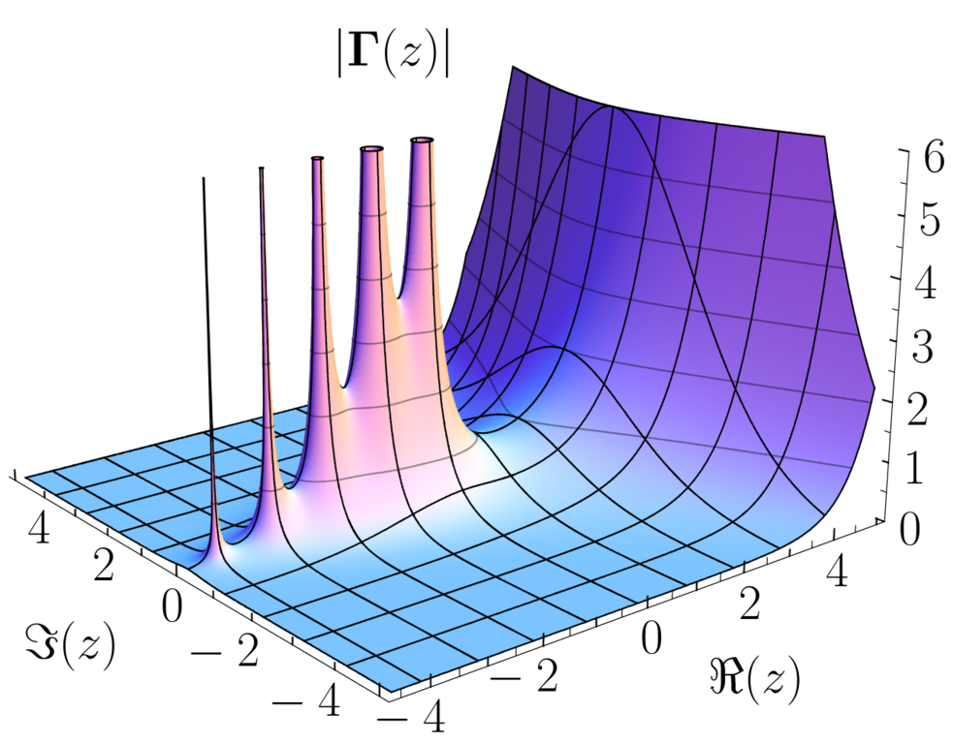
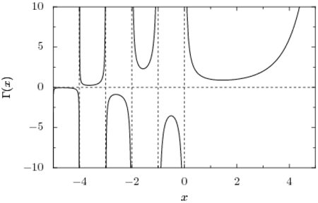
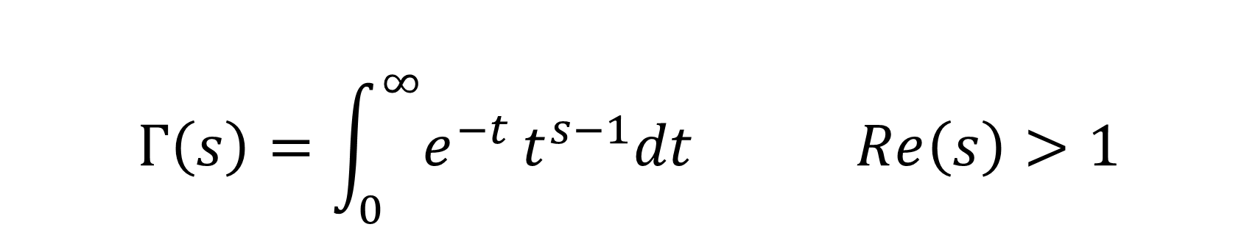

Gamma Function $Γ$
$$Γ\left(s\right)=\int_{0}^{∞}{e^{−t}}t^{s−1}dt Re\left(s\right)>1$$

Slide 12
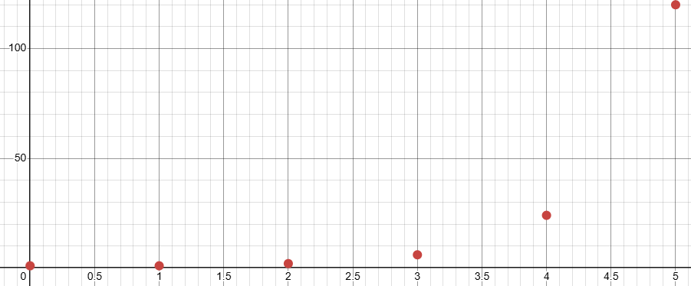

Gamma Function $Γ$
$Γ\left(n+1\right)=n!$ where $n∈ℤ_{≥0}$

Slide 13
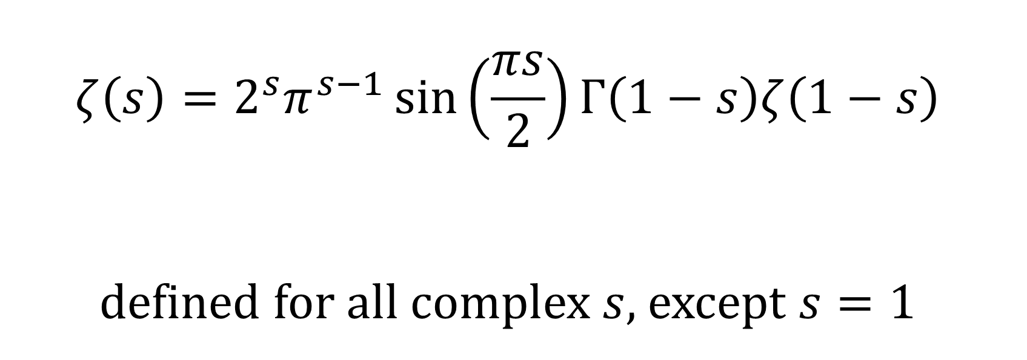

Functional Equation of $ζ(s)$
$$ζ\left(s\right)=2^{s}π^{s−1}\sin\left(\frac{πs}{2}\right)Γ\left(1−s\right)ζ\left(1−s\right)$$
defined for all complex $s$, except $s=1$

Slide 14
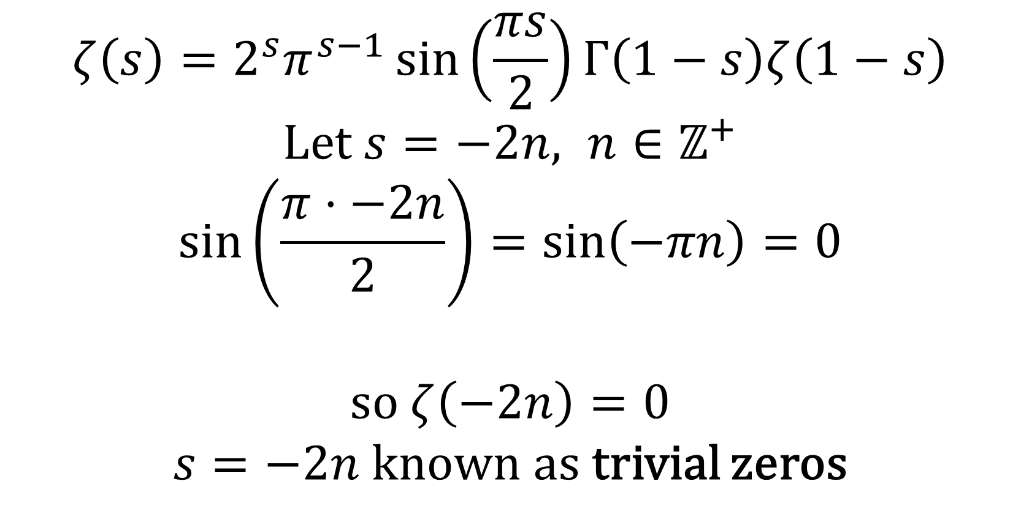

Zeros of $ζ(s)$
$$ζ\left(s\right)=2^{s}π^{s−1}\sin\left(\frac{πs}{2}\right)Γ\left(1−s\right)ζ\left(1−s\right)$$
Let $s=−2n, n∈ℤ^{+}$
$$\sin\left(\frac{π⋅−2n}{2}\right)=\sin\left(−πn\right)=0$$
so $ζ\left(−2n\right)=0$
$s=−2n$ known as trivial zeros

Slide 15
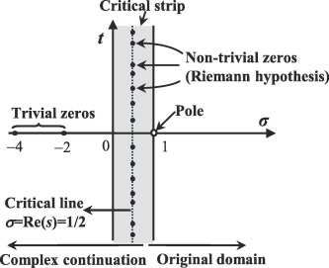
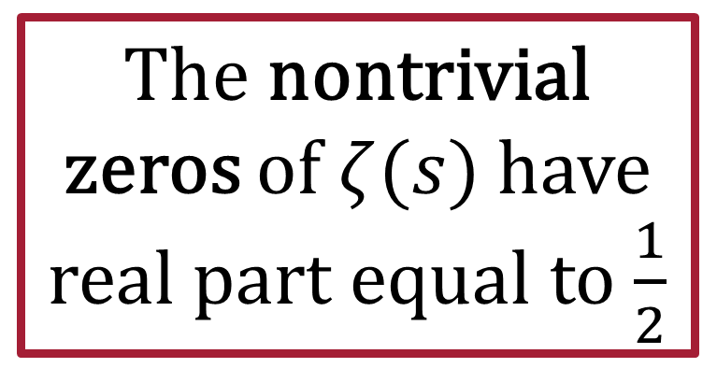
Riemann Hypothesis
The nontrivial zeros of $ζ(s)$ have real part equal to $\frac{1}{2}$

Slide 16
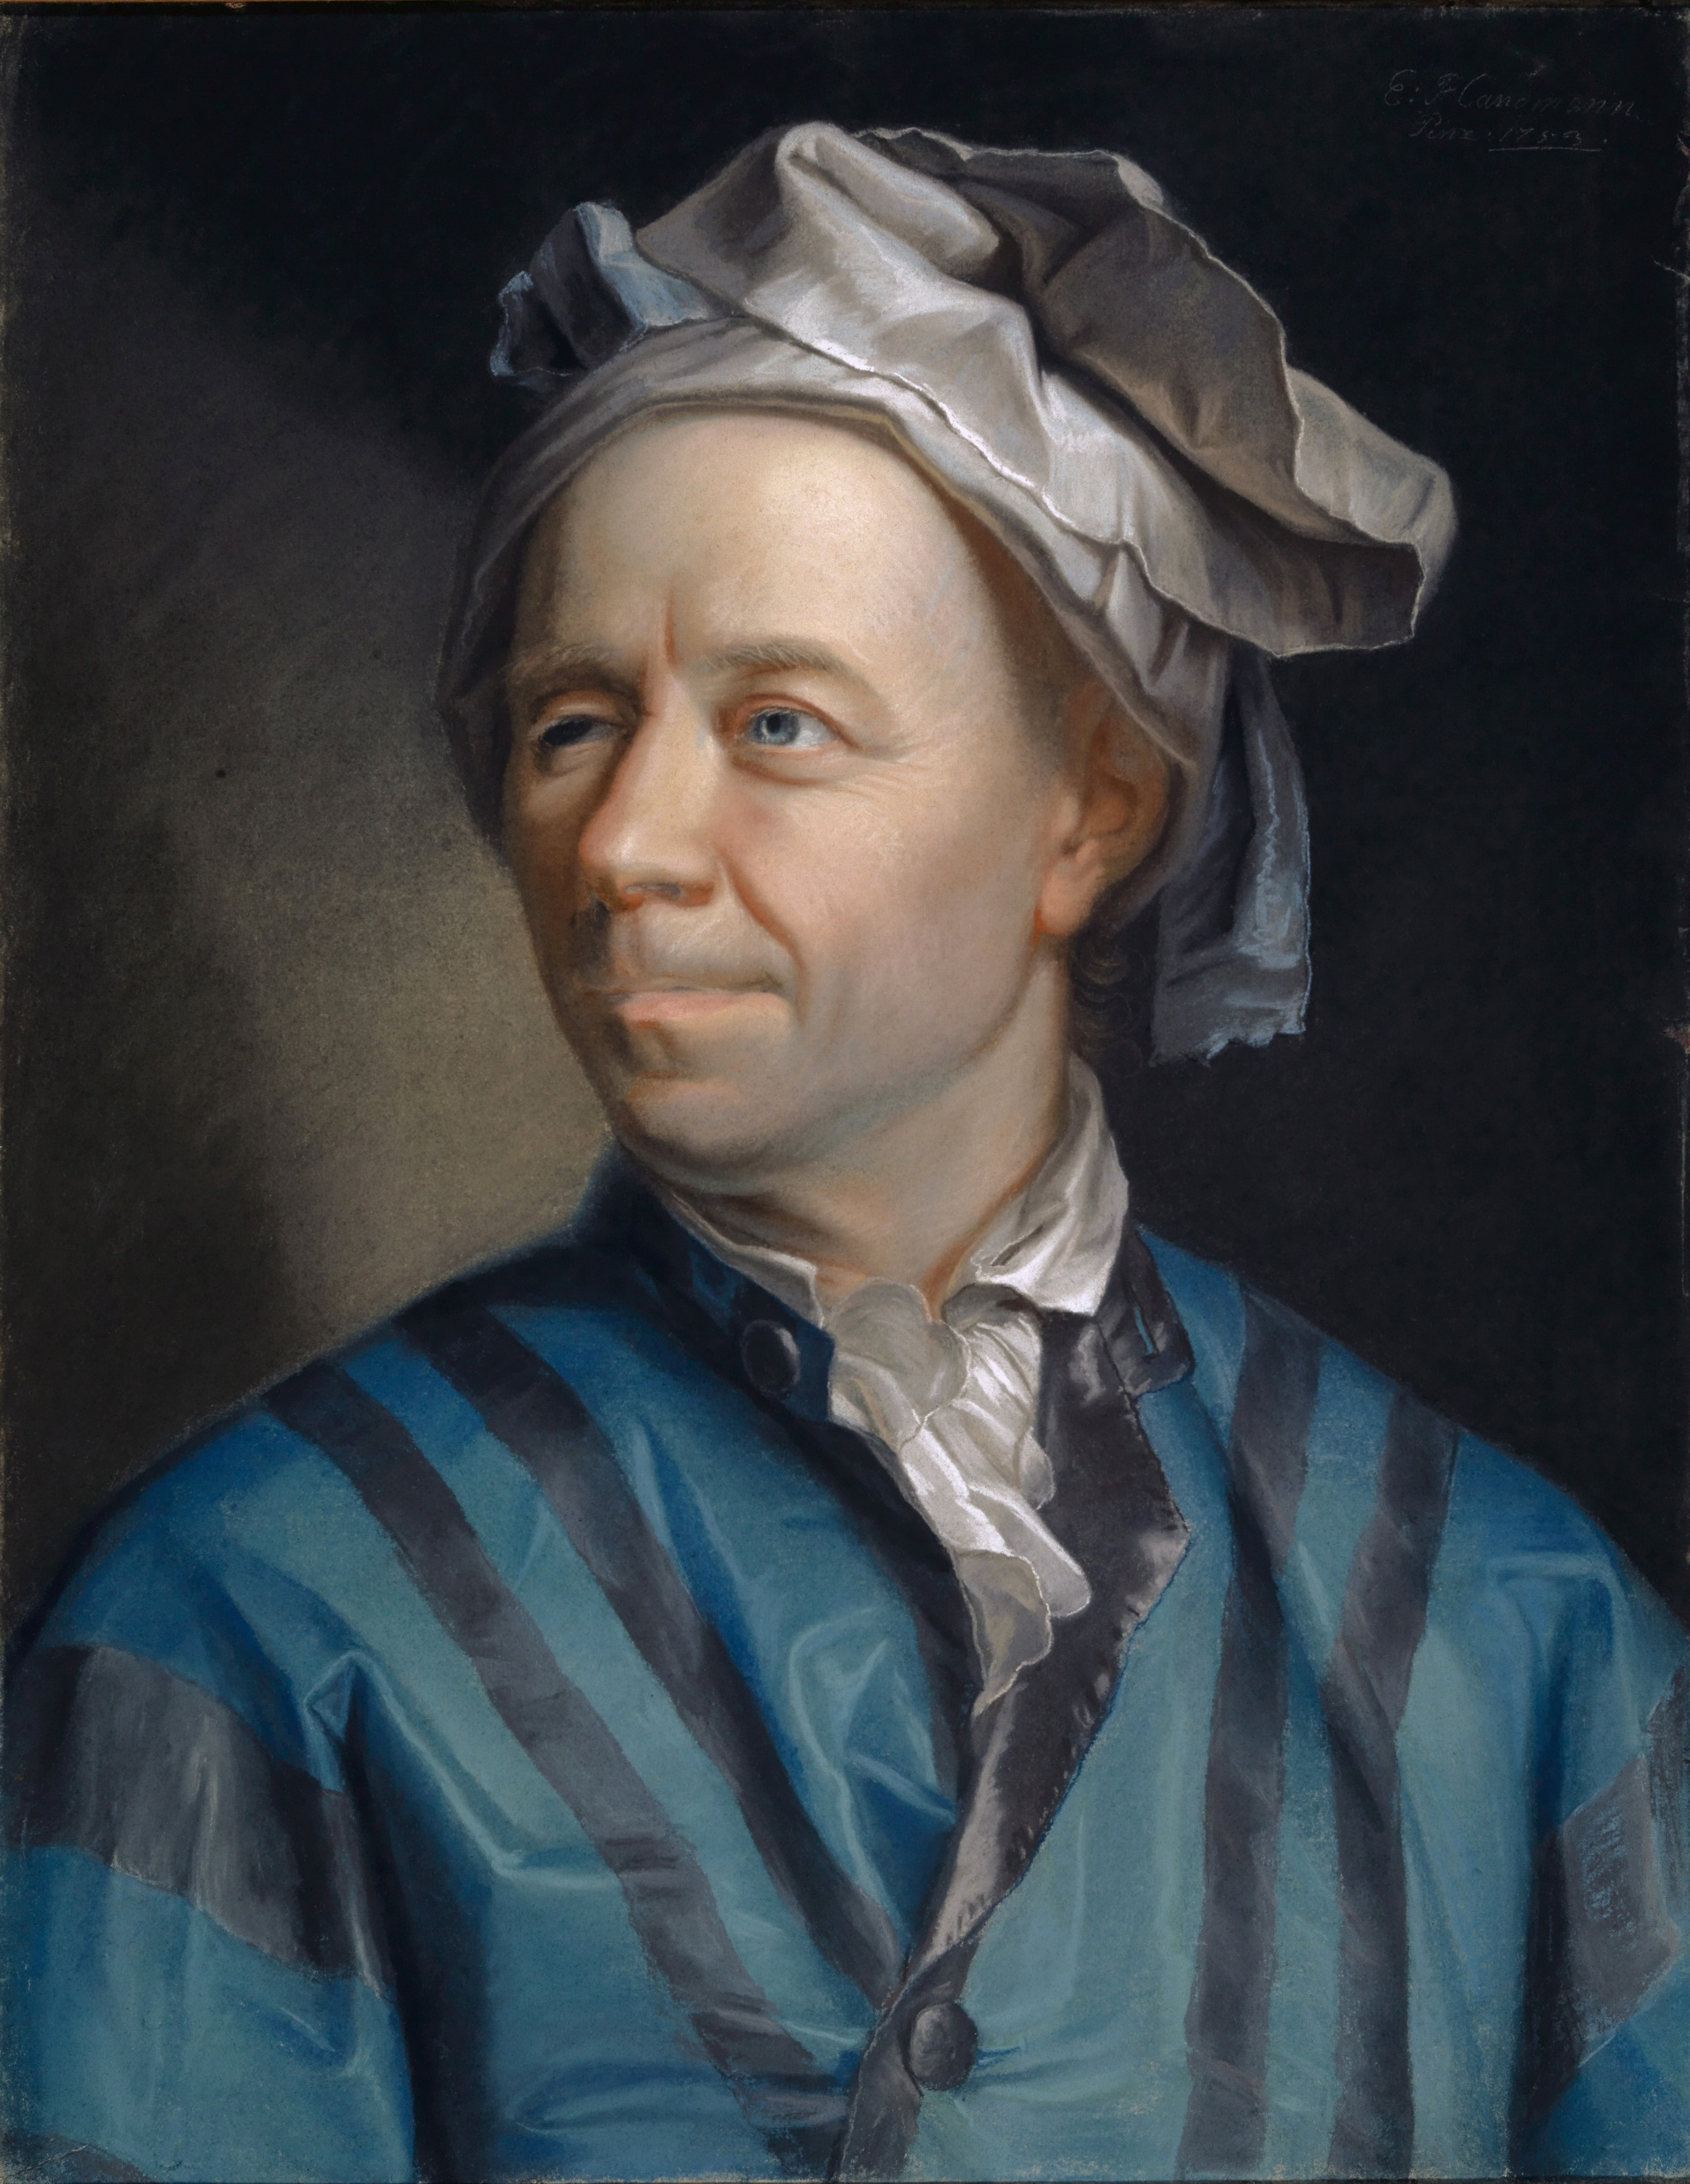
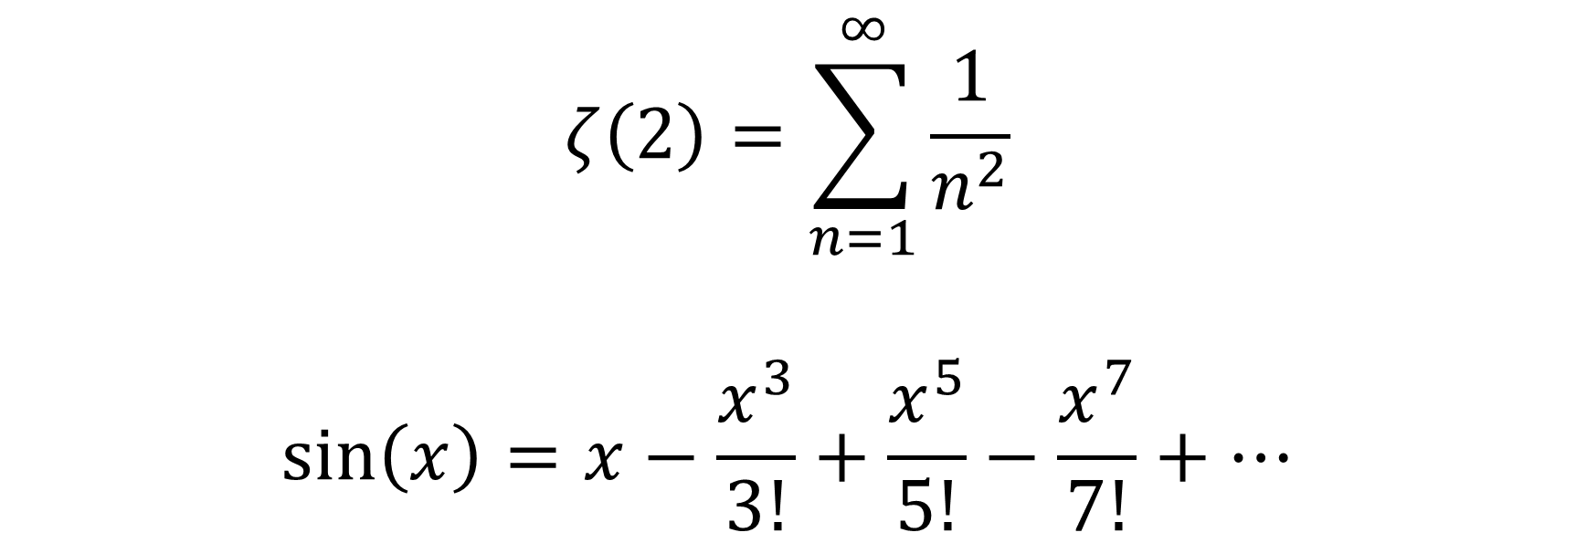

Basel Problem $ζ(2)$
$$ζ\left(2\right)=\sum_{n=1}^{∞}{\frac{1}{n^{2}}}$$
$$\sin\left(x\right)=x−\frac{x^{3}}{3!}+\frac{x^{5}}{5!}−\frac{x^{7}}{7!}+…$$

Slide 17
Weierstrass Factorization Theorem
Any function that is analytic over the entire complex plane can be written as a product involving its zeros

Slide 18
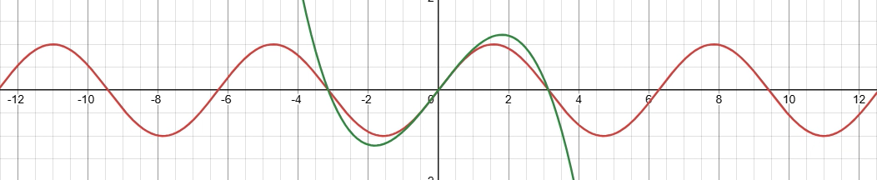
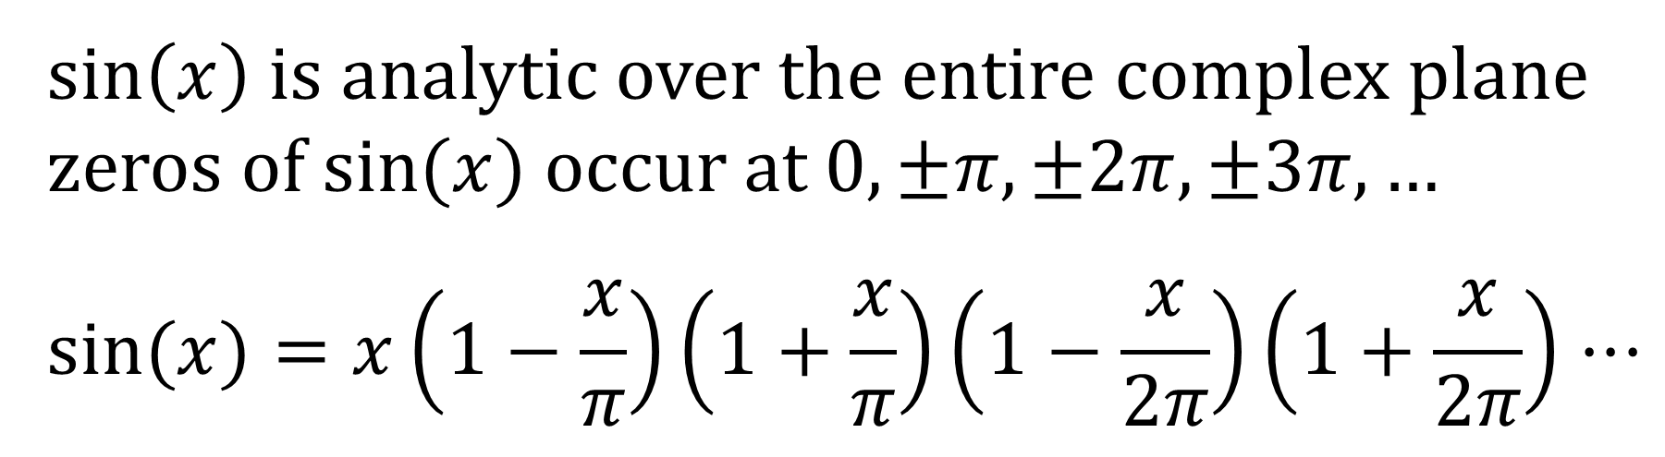
Weierstrass Factorization Theorem
$\sin\left(x\right)$ is analytic over the entire complex plane
zeros of $sin⁡(x)$ occur at $0,±π,±2π,±3π,…$
$$sin⁡(x)=x\left(1−\frac{x}{π}\right)\left(1+\frac{x}{π}\right)\left(1−\frac{x}{2π}\right)\left(1+\frac{x}{2π}\right)⋅⋅⋅$$

Slide 19

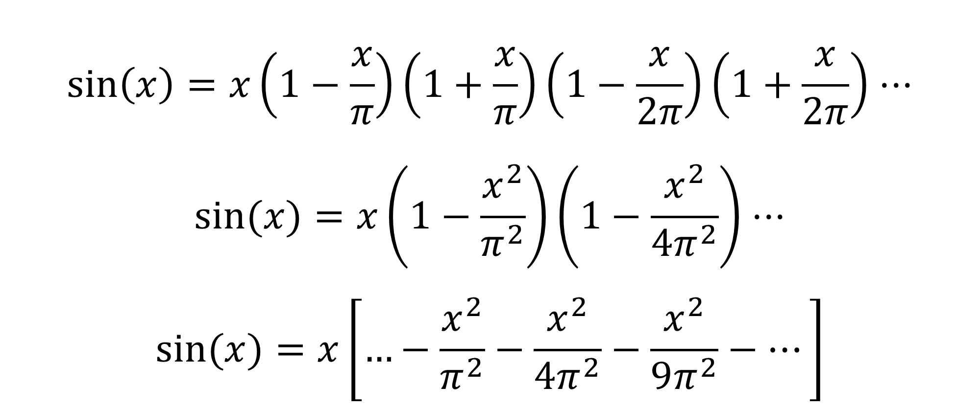
Basel Problem $ζ(2)$ Cont.
$$\sin\left(x\right)=x\left(1−\frac{x}{π}\right)\left(1+\frac{x}{π}\right)\left(1−\frac{x}{2π}\right)\left(1+\frac{x}{2π}\right)⋅⋅⋅$$
$$sin⁡(x)=x\left(1−\frac{x^{2}}{π^{2}}\right)\left(1−\frac{x^{2}}{4π^{2}}\right)⋅⋅⋅$$
$$sin⁡(x)=x\left[…−\frac{x^{2}}{π^{2}}−\frac{x^{2}}{4π^{2}}−\frac{x^{2}}{9π^{2}}−…\right]$$

Slide 20
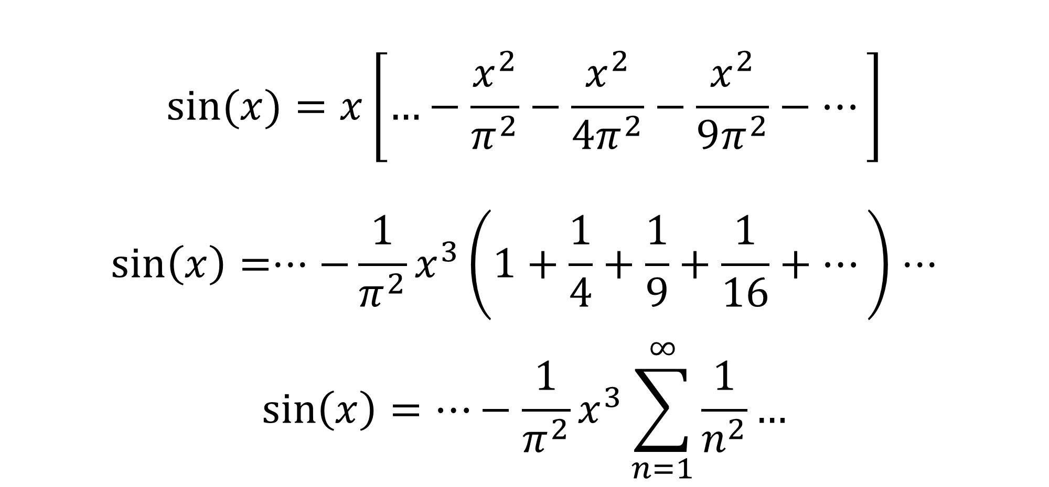
Basel Problem $ζ(2)$ Cont.
$$sin⁡(x)=x\left[…−\frac{x^{2}}{π^{2}}−\frac{x^{2}}{4π^{2}}−\frac{x^{2}}{9π^{2}}−…\right]$$
$$\sin\left(x\right)=⋅⋅⋅−\frac{1}{π^{2}}x^{3}\left(1+\frac{1}{4}+\frac{1}{9}+\frac{1}{16}+…\right)⋅⋅⋅$$
$$\sin\left(x\right)=…−\frac{1}{π^{2}}x^{3}\sum_{n=1}^{∞}{\frac{1}{n^{2}}}…$$

Slide 21
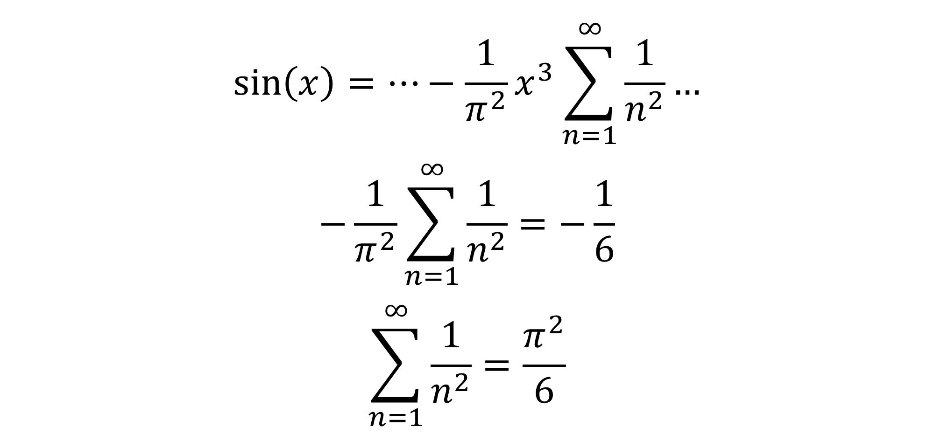
Basel Problem $ζ(2)$ Cont.
$$\sin\left(x\right)=…−\frac{1}{π^{2}}x^{3}\sum_{n=1}^{∞}{\frac{1}{n^{2}}}…$$
$$−\frac{1}{π^{2}}\sum_{n=1}^{∞}{\frac{1}{n^{2}}}=−\frac{1}{6}$$
$$\sum_{n=1}^{∞}{\frac{1}{n^{2}}}=\frac{π^{2}}{6}$$

Slide 22
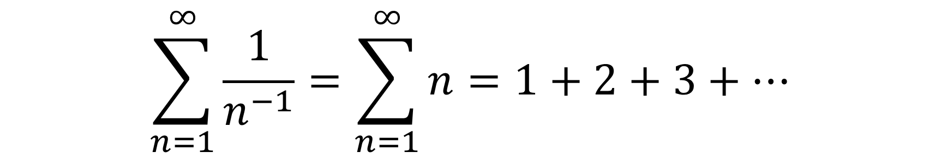
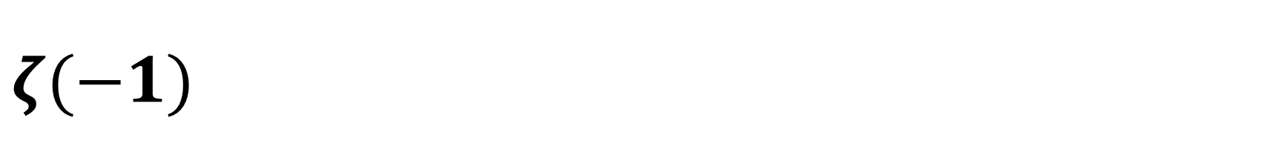
$$ζ(−1)$$
$$\sum_{n=1}^{∞}{\frac{1}{n^{−1}}}=\sum_{n=1}^{∞}{n}=1+2+3+…$$

Slide 23
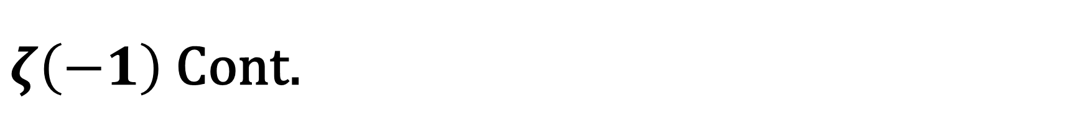
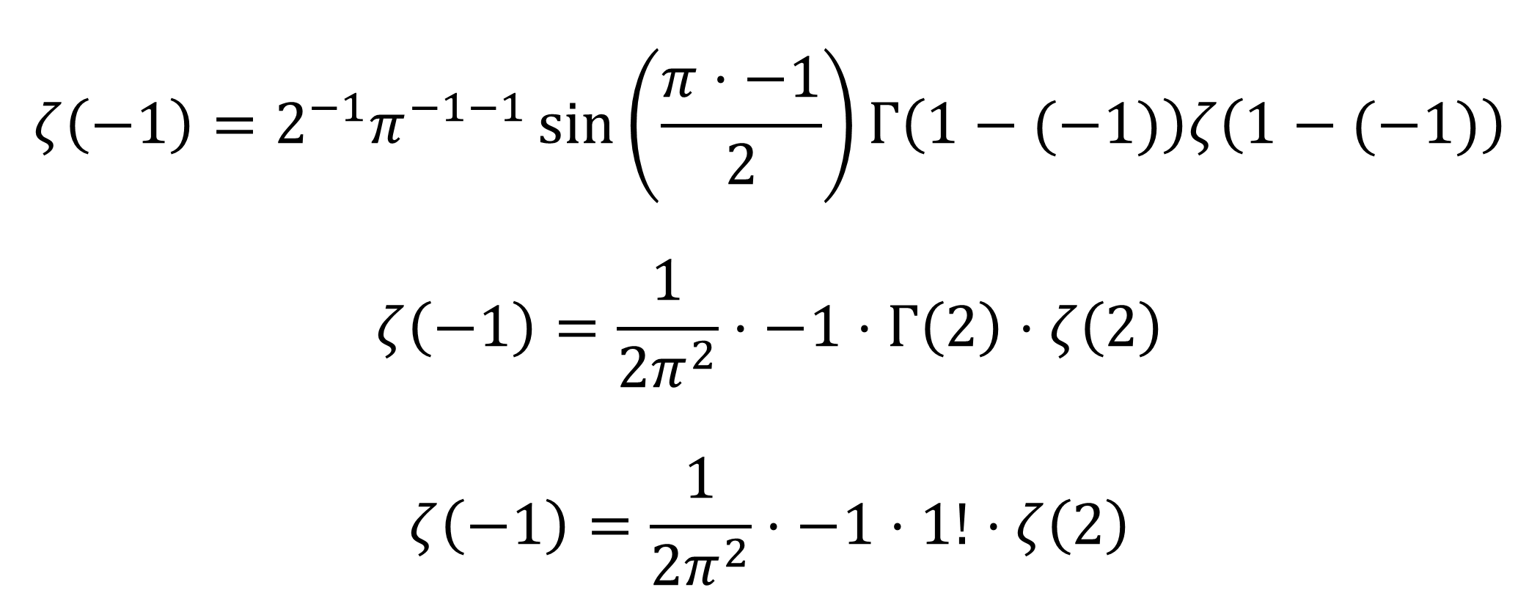
$ζ\left(−1\right)$ Cont.
$$ζ\left(−1\right)=2^{−1}π^{−1−1}\sin\left(\frac{π⋅−1}{2}\right)Γ\left(1−(−1)\right)ζ\left(1−(−1)\right)$$
$$ζ\left(−1\right)=\frac{1}{2π^{2}}⋅−1⋅Γ\left(2\right)⋅ζ\left(2\right)$$
$$ζ\left(−1\right)=\frac{1}{2π^{2}}⋅−1⋅1!⋅ζ\left(2\right)$$

Slide 24
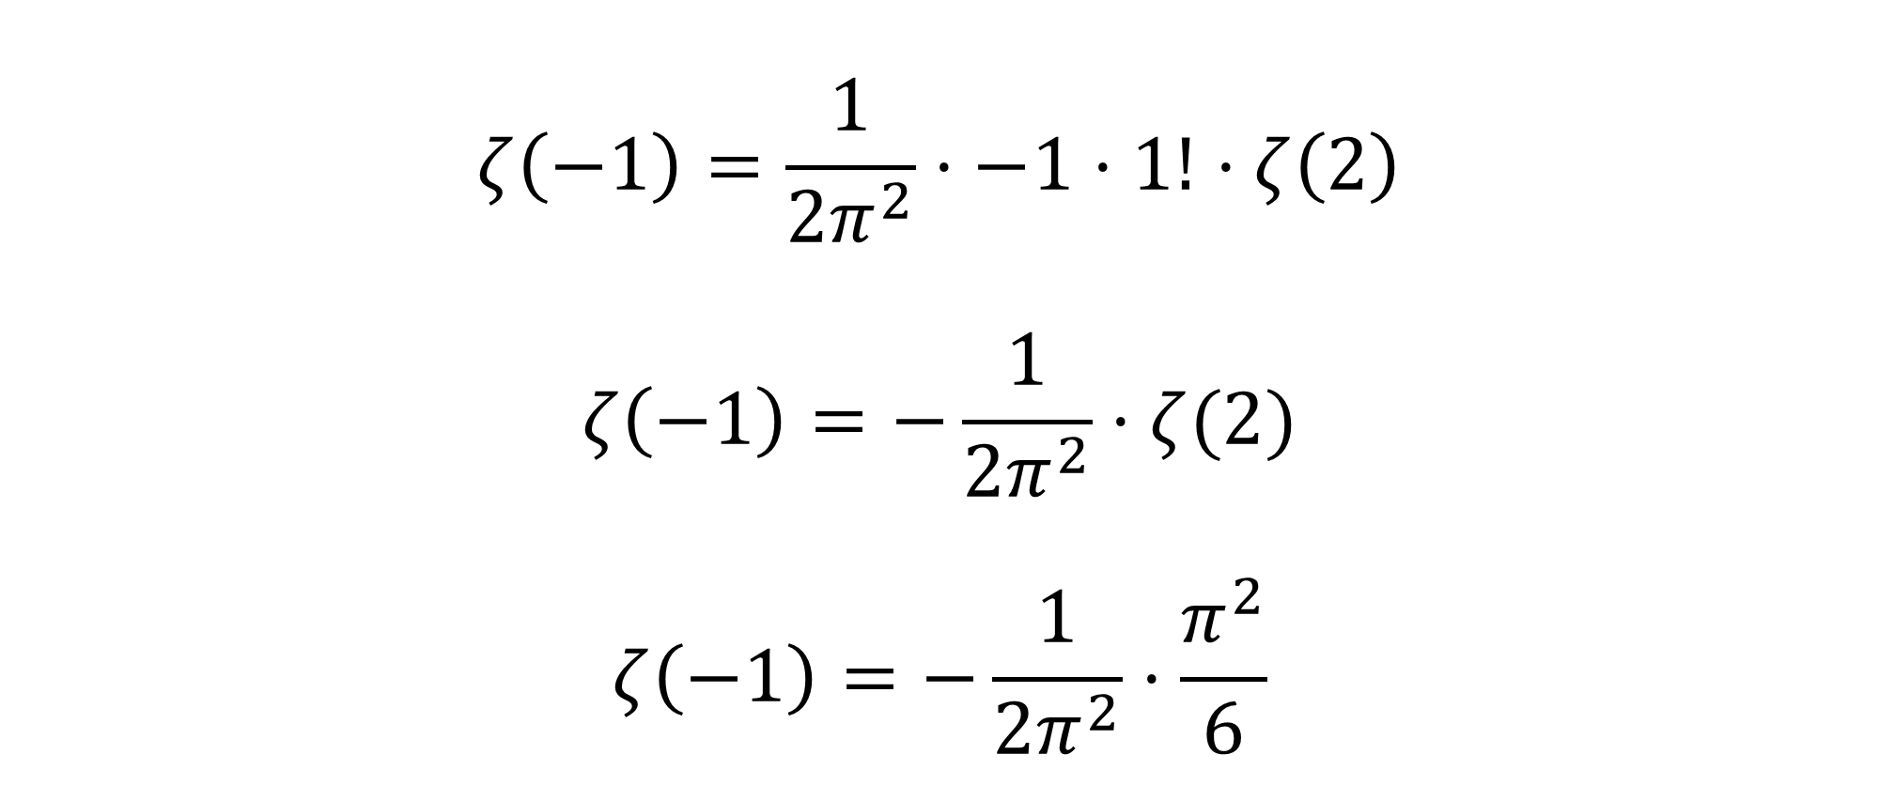
$ζ\left(−1\right)$ Cont.
$$ζ\left(−1\right)=\frac{1}{2π^{2}}⋅−1⋅1!⋅ζ\left(2\right)$$
$$ζ\left(−1\right)=−\frac{1}{2π^{2}}⋅ζ(2)$$
$$ζ\left(−1\right)=−\frac{1}{2π^{2}}⋅\frac{π^{2}}{6}$$

Slide 25
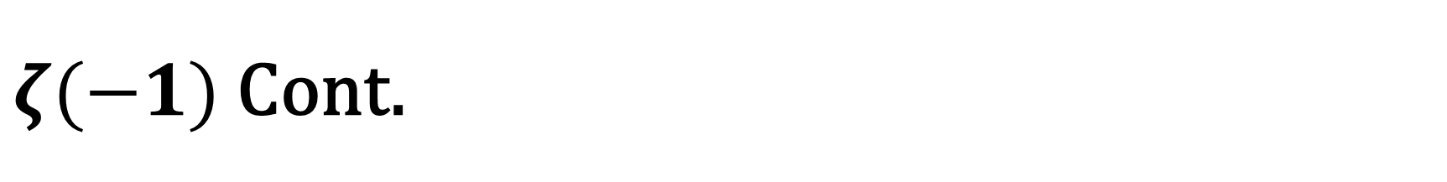
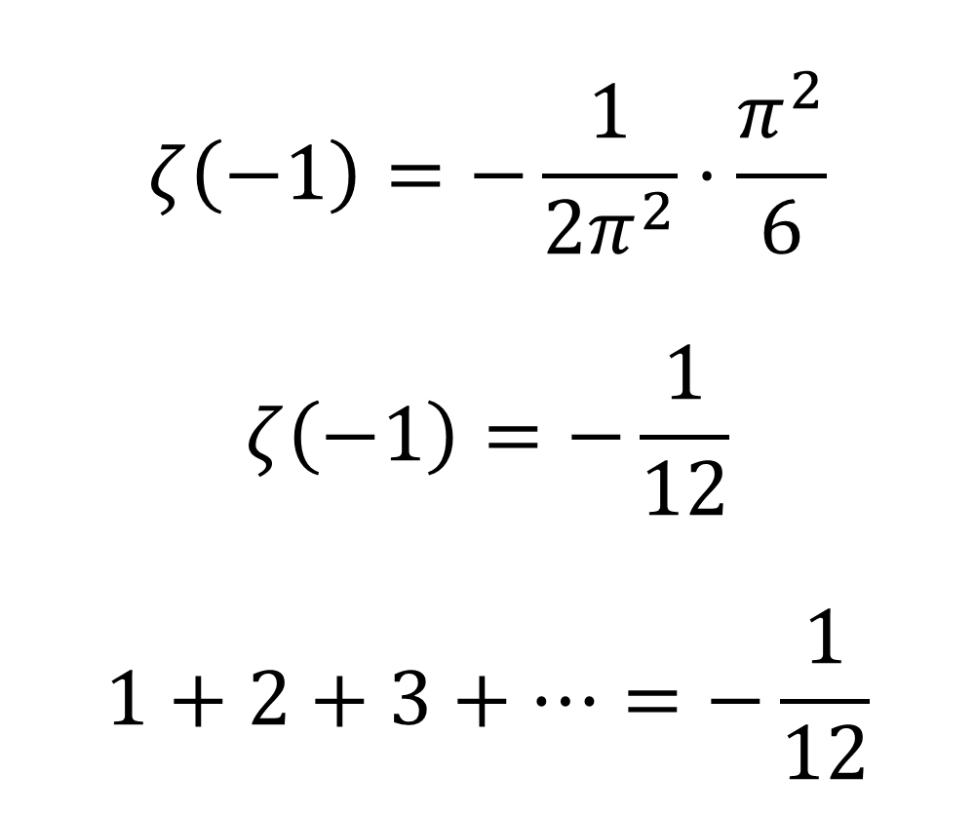
$ζ(−1)$ Cont.
$$ζ\left(−1\right)=−\frac{1}{2π^{2}}⋅\frac{π^{2}}{6}$$
$$ζ\left(−1\right)=−\frac{1}{12}$$
$$1+2+3+…=−\frac{1}{12}$$

Slide 26






$$?$$
$$?$$
$$?$$
$$1+2+3+…=−\frac{1}{12}$$
$$?$$
$$?$$

Slide 27
References
https://math.iisc.ac.in/seminar-slides/2019/2019-12-18-KenOno-1.pdf
https://math.uchicago.edu/~may/REU2014/REUPapers/Moros.pdf
https://www.math.ucdavis.edu/~temple/MAT21B/Riemann-Biography.pdf
http://sections.maa.org/epadel/awards/studentpaper/winners/2011_Yoder.pdf
https://www.math.cmu.edu/~bwsulliv/basel-problem.pdf

Slide 28
Thank you! Any Questions?

Slide 29
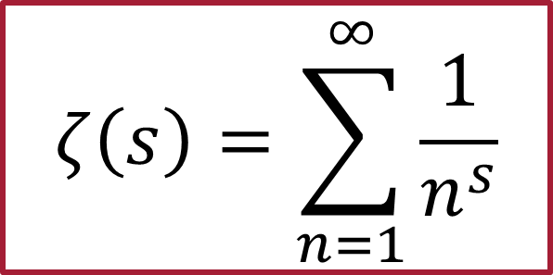
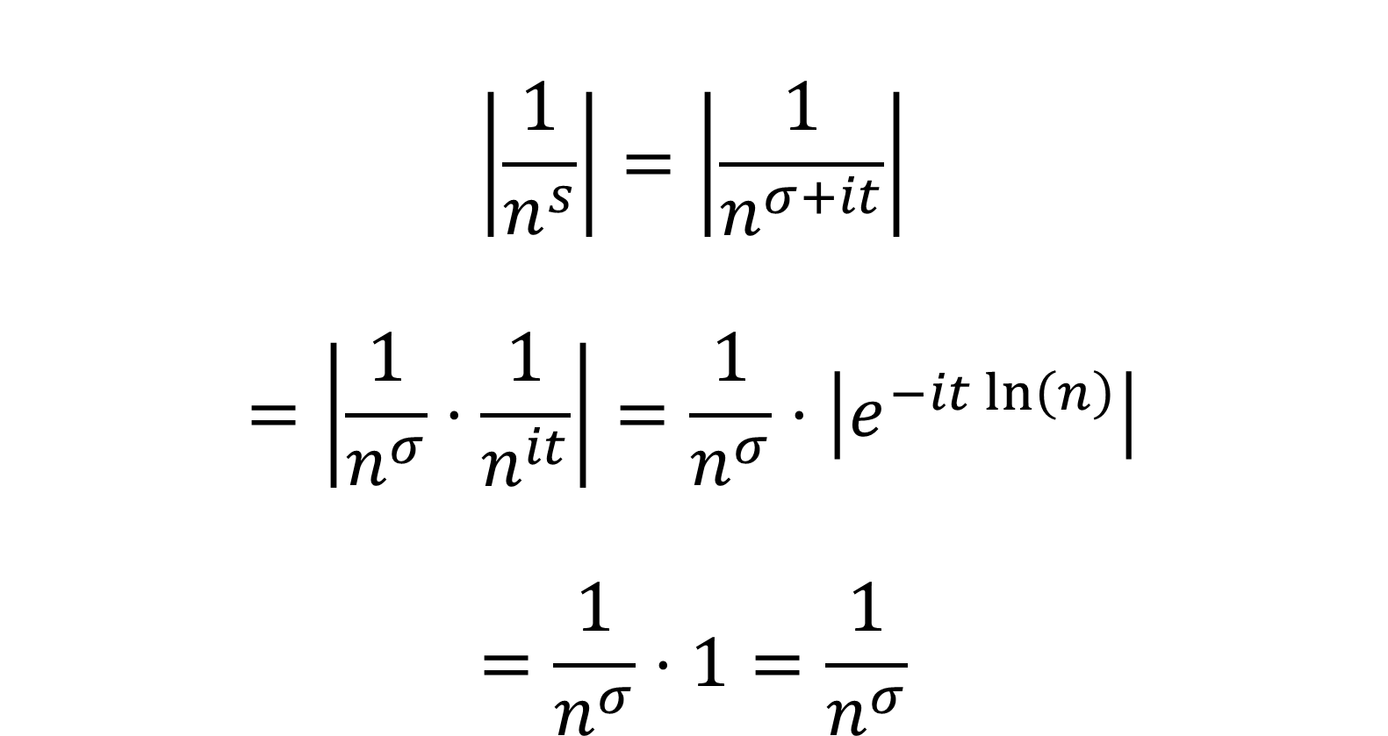
Convergence
$$ζ\left(s\right)=\sum_{n=1}^{∞}{\frac{1}{n^{s}}}$$
$$\left|\frac{1}{n^{s}}\right|=\left|\frac{1}{n^{σ+it}}\right|$$
$$=\left|\frac{1}{n^{σ}}⋅\frac{1}{n^{it}}\right|=\frac{1}{n^{σ}}⋅\left|e^{−it\ln\left(n\right)}\right|$$
$$=\frac{1}{n^{σ}}⋅1=\frac{1}{n^{σ}}$$

Slide 30
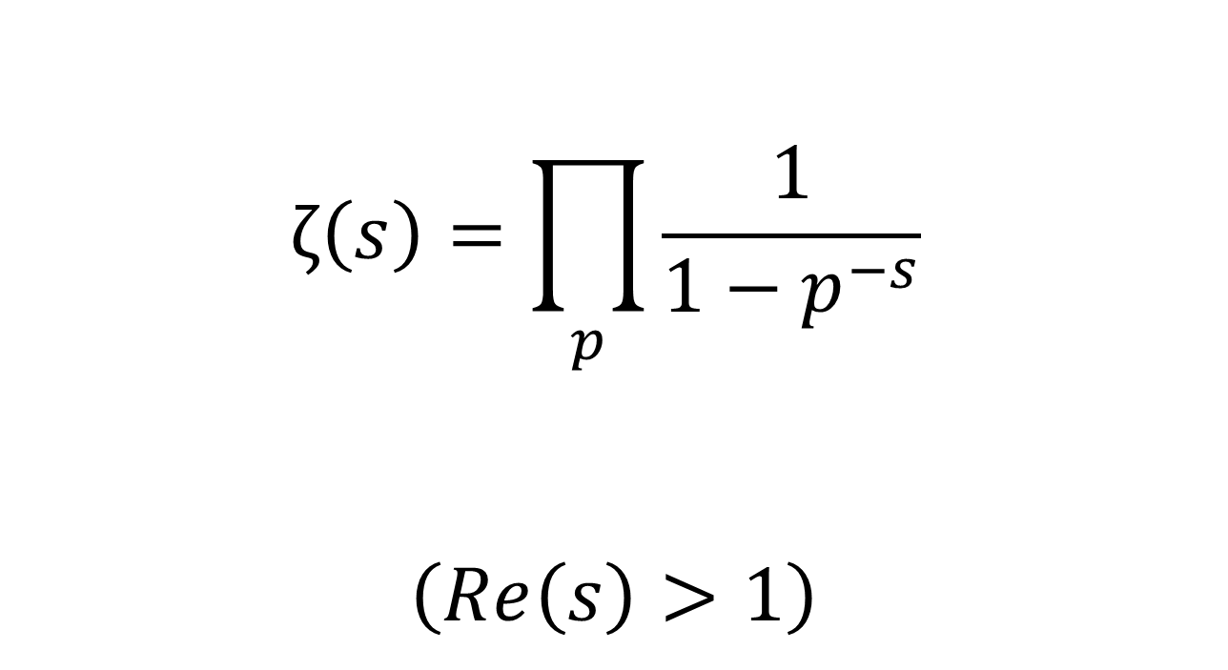
Euler Product Formula
$$ζ\left(s\right)=\prod_{p}{\frac{1}{1−p^{−s}}}$$
$$\left(Re\left(s\right)>1\right)$$

Slide 31
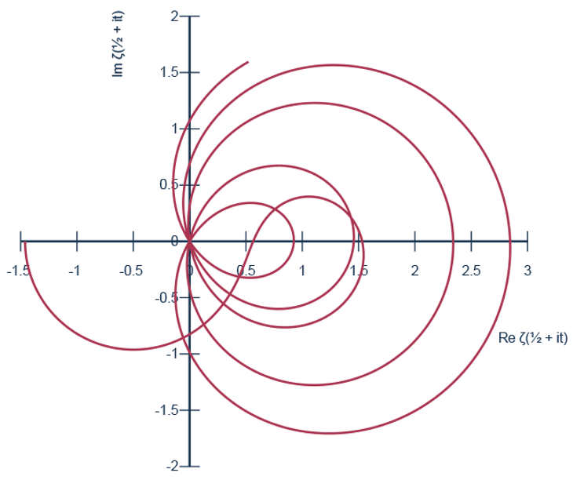
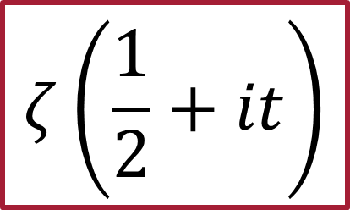
$$ζ\left(\frac{1}{2}+it\right)$$

